Slide 1

Team Values Boost Customer Value
Opal Perry
Divisional CIO, Claims
Allstate Insurance
@_OpalPerry

Slide 2


3

Slide 3
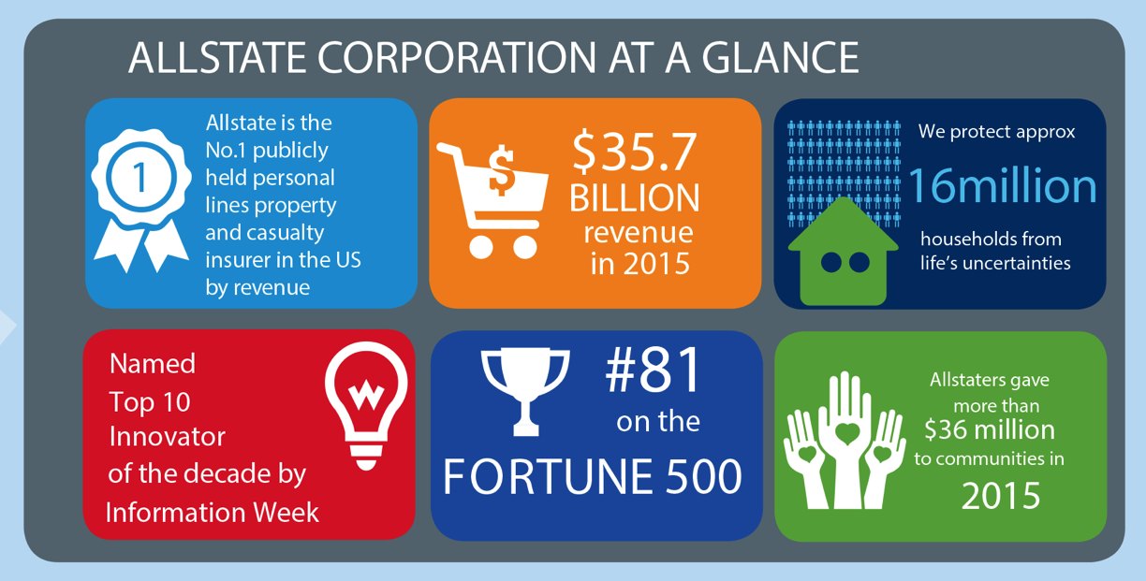
2

Slide 4

4

Slide 5
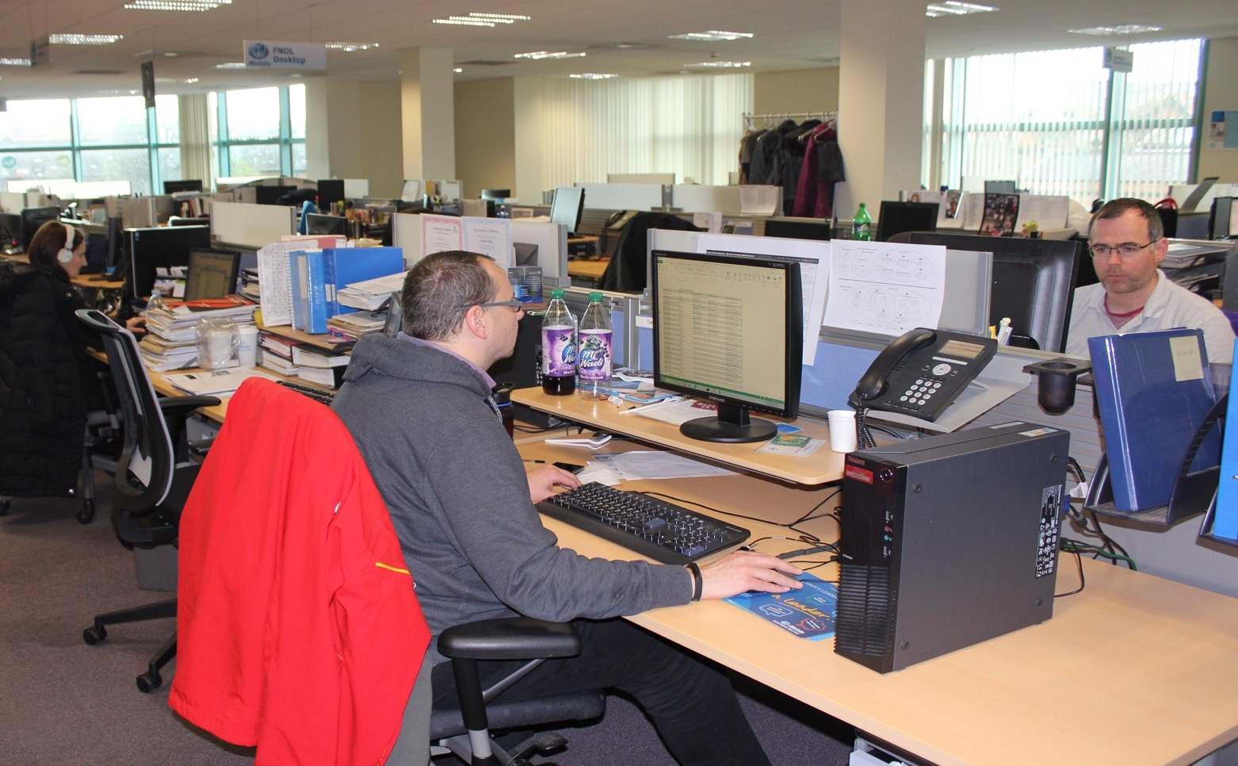
7

Slide 6

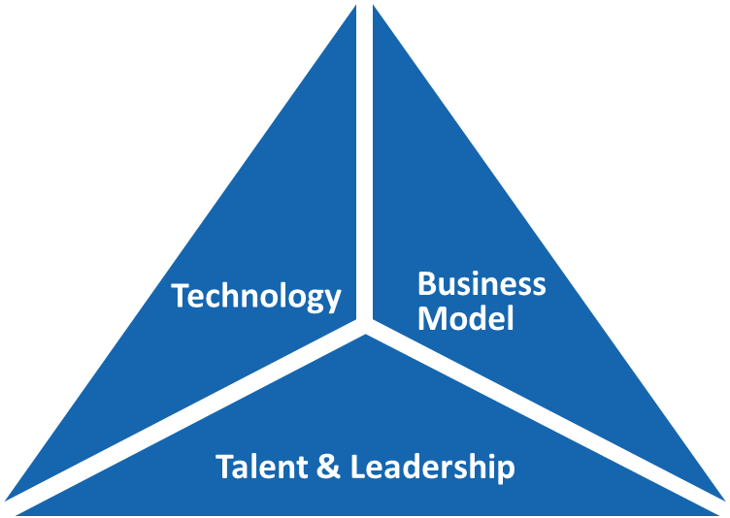
“What capabilities we provide”
“How we work”
“How our people deliver success”
5

Slide 7

@CompoZedLabs
6

Slide 8


As an Allstate Leader
I need immediate access to Major Incident Report info
To help prioritize my time & add the most value.
8
Notes:
‘

Slide 9
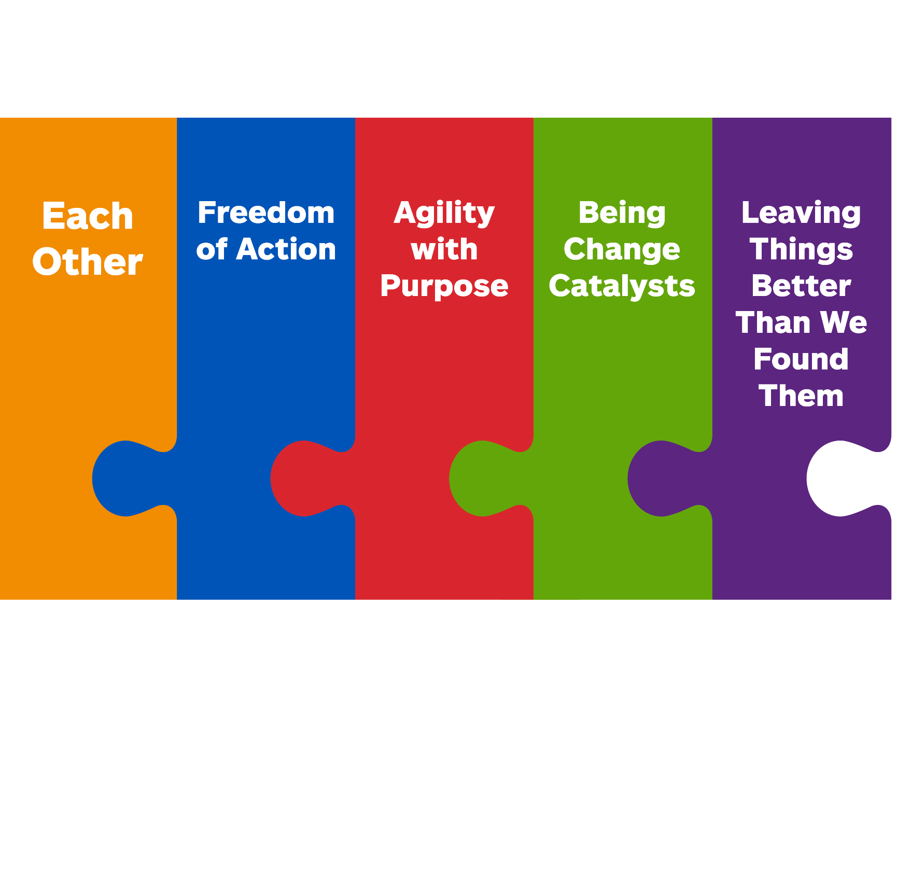
Check In
Check In
Check In
Check In
10

Slide 10
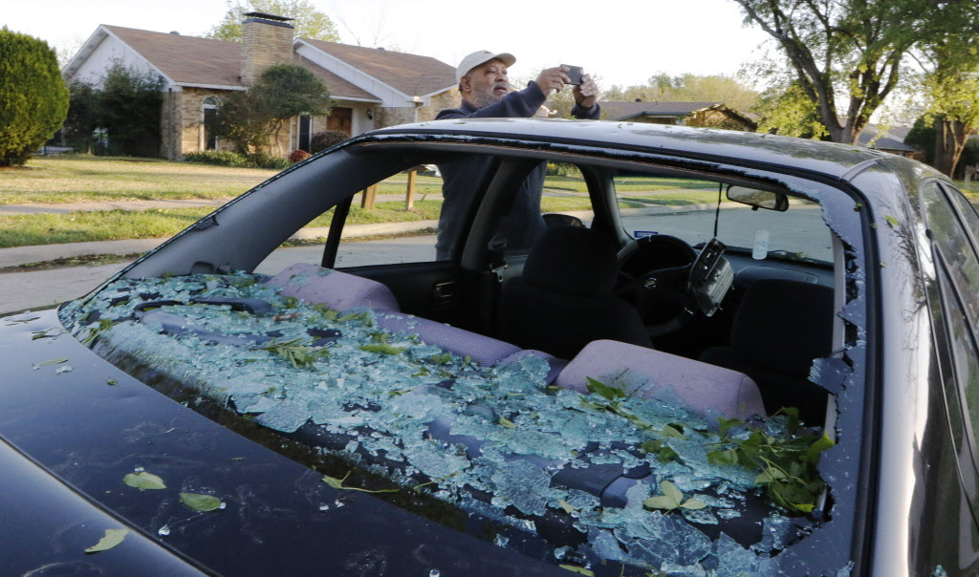
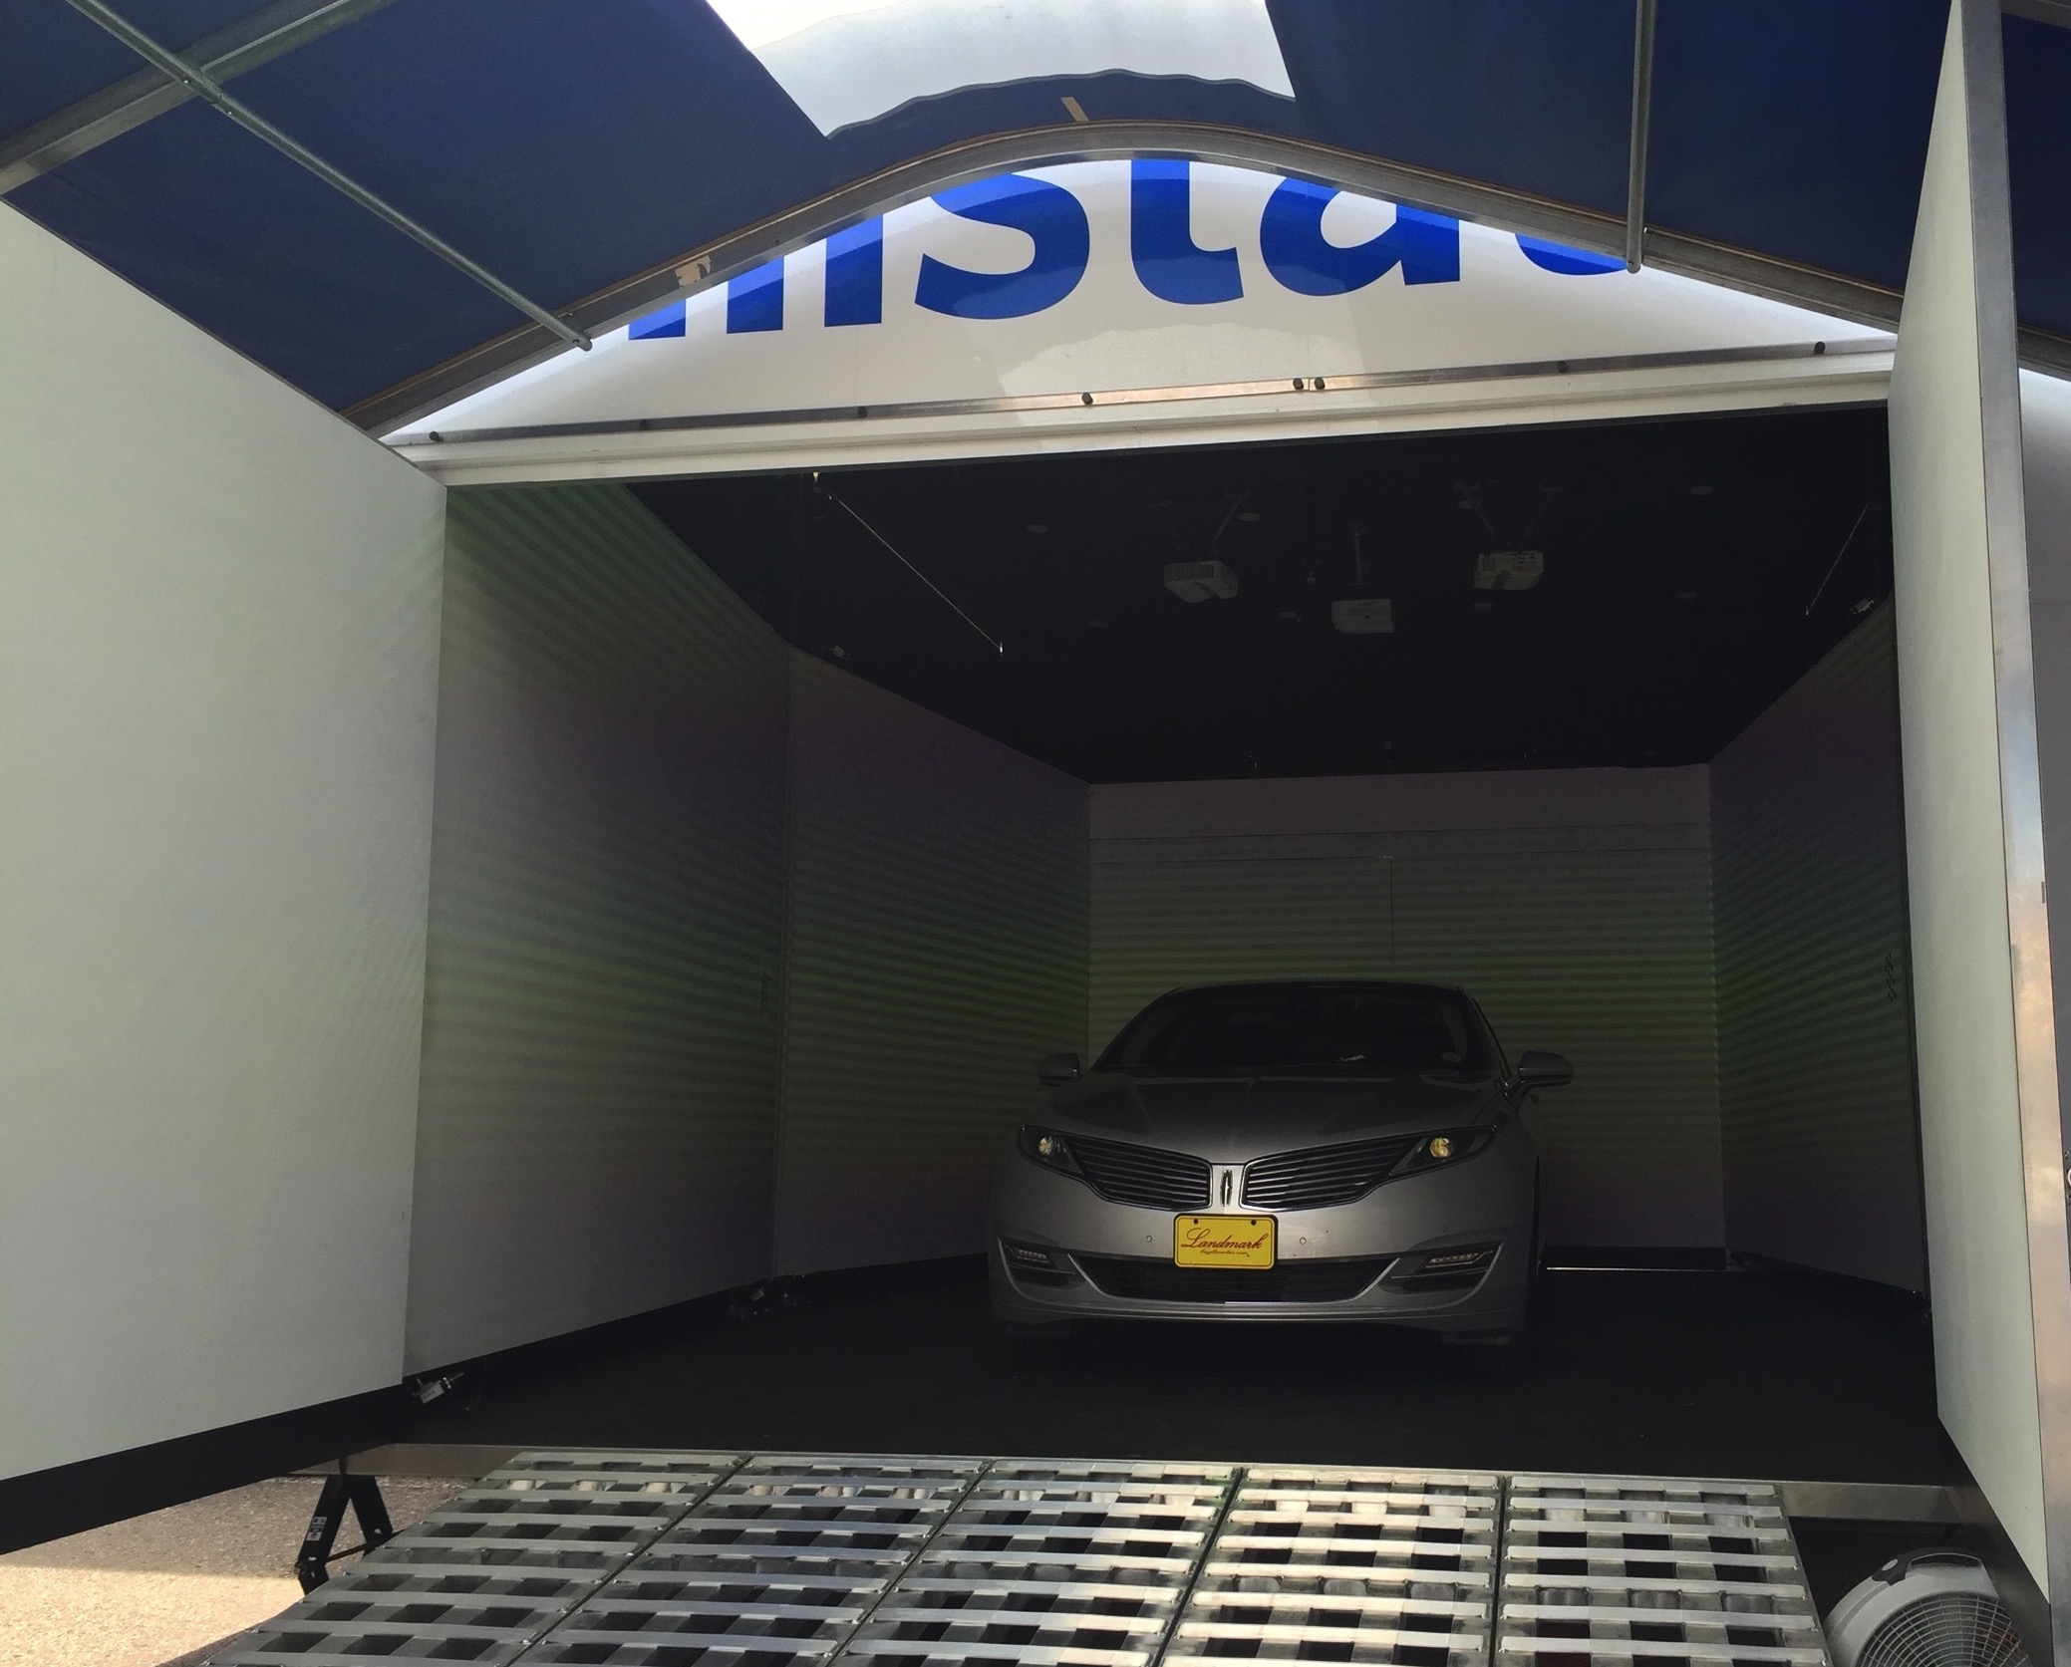
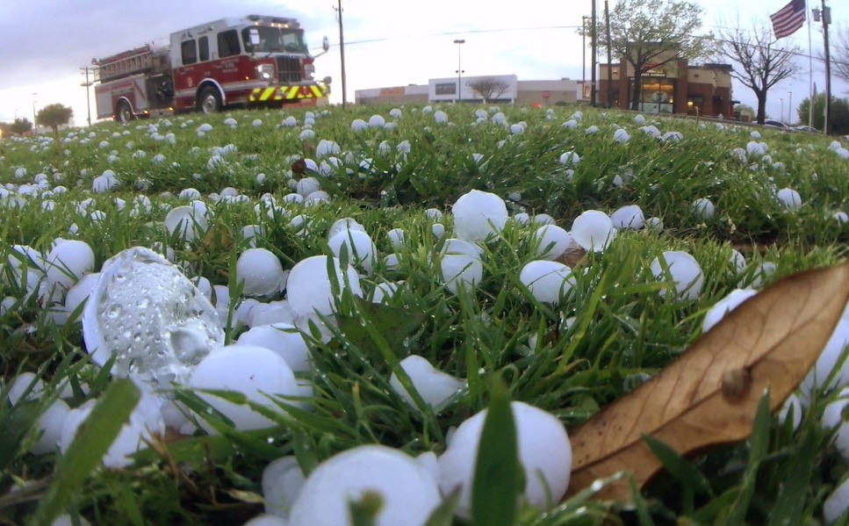
11

Slide 11

Global Talent
Invest In Experiments
Customer centric
Speed to value
Comfort with ambiguity
Reshaping our work environment
Tools & Infrastructure
12

Slide 12
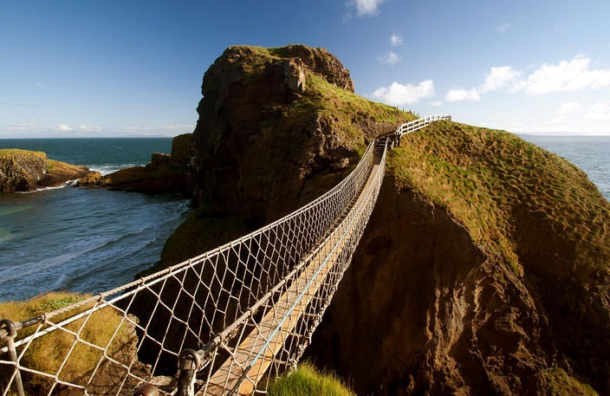
13

Slide 13
THANK
YOU

